Slide 1
Yacc

Slide 2
Lexical vs. Syntactic Analysis
Phase | Input | Output
Lexer | Sequence of characters | Sequence of tokens
Parser | Sequence of tokens | Parse tree
Lex is a tool for writing lexical analyzers.
Yacc is a tool for constructing parsers.
Slide credit: Wes Weimer

Slide 3
The Functionality of the Parser
Input: sequence of tokens from lexer – e.g., the lex files you will write in the 1st phase of your course project.
Output: parse tree of the program
Also called an abstract syntax tree
Output: error if the input is not valid – e.g., “parse error on line 3"
Slide credit: Wes Weimer

Slide 4
Example
Cool program text
if x = y then 1 else 2 fi
Parser input (tokens)
IF ID = ID THEN INT ELSE INT FI
Parser output (tree)
Slide credit: Wes Weimer

Slide 5
The Role of the Parser
Not all sequences of tokens are programs
– then x * / + 3 while x ; y z then
The parser must distinguish between valid and invalid sequences of tokens
We need context free grammars.
Yacc stands for yet another compiler to compiler.
Reads a specification file that codifies the grammar of a language and generates a parsing routine

Slide 6

1970

Slide 7
Yacc
Yacc specification describes a Context Free Grammar (CFG), that can be used to generate a parser.
Elements of a CFG:
1. Terminals: tokens and literal characters,
2. Variables (nonterminals): syntactical elements,
3. Production rules, and
4. Start rule.

Slide 8
Yacc
Format of a production rule:
symbol: definition
{action}
;
Example:
A → Bc is written in yacc as a: b 'c';

Slide 9
Yacc Format
Format of a yacc specification file:
declarations
%%
grammar rules and associated actions
%%
C programs

Slide 10
Declarations
To define tokens and their characteristics
%token: declare names of tokens
%left: define left-associative operators
%right: define right-associative operators
%nonassoc: define operators that may not associate with themselves
%type: declare the type of variables

Slide 11
Declarations
%union: declare multiple data types for semantic values
%start: declare the start symbol (default is the first variable in rules)
%prec: assign precedence to a rule
%{
C declarations directly copied to the resulting C program
%} (e.g., variables, types, macros…)

Slide 12
A simple yacc specification to accept L={ a^{n}b^{n} | n>1}.
/*anbn0.y */
%token A B
%%
start: anbn '\n' {return 0;}
anbn: A B
| A anbn B
;
%%
#include "lex.yy.c"

Slide 13
lex – yacc pair
/* anbn0.l */
%%
a return (A);
b return (B);
. return (yytext[0]);
\n return ('\n');
/*anbn0.y */
%token A B
%%
start: anbn '\n' {return 0;}
anbn: A B
| A anbn B
;
%%
#include "lex.yy.c"

Slide 14
Running yacc on Linux
In Linux there is no liby.a library for yacc functions
You have to add the following lines to end of your
yacc specification file
int yyerror(char *s)
{
printf(“%s\n”, s);
}
int main(void)
{
yyparse();
}
Then type
gcc -o exe_file y.tab.c -lfl
Notes:
yyparse();

Slide 15
Printing messages
If the input stream does not match start, the default message of "syntax error" is printed and program terminates.
However, customized error messages can be generated.
/*anbn1.y */
%token A B
%%
start: anbn '\n' {printf(" is in anbn\n");
return 0;}
anbn: A B
| A anbn B
;
%%
#include "lex.yy.c"
yyerror(s)
char *s;
{ printf("%s, it is not in anbn\n", s);
}

Slide 16
Example Output
$anbn
aabb
is in anbn
$anbn
acadbefbg
Syntax error, it is not in anbn

Slide 17
A grammar to accept L = {a^{n}b^{n} | n >= 0}.
/*anbn_0.y */
%token A B
%%
start: anbn '\n' {printf(" is in anbn_0\n");
return 0;}
anbn: empty
| A anbn B
;
empty: ;
%%
#include "lex.yy.c"
yyerror(s)
char *s;
{ printf("%s, it is not in anbn_0\n", s);

Slide 18
Recursive Rules
Although right-recursive rules can be used in yacc, left-recursive rules are preferred, and, in general, generate more efficient parsers.

Slide 19
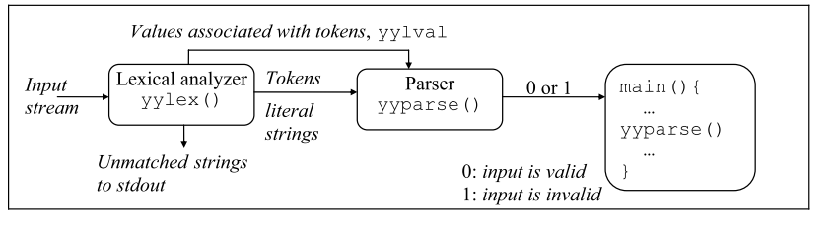
yylval
yylex() function returns an integer, the token number, representing the kind of token read. If there is a value associated with that token, it should be assigned to the external variable yylval.

Slide 20
yylval
The type of yylval is int by default. To change the type of yylval use macro YYSTYPE in the declarations section of a yacc specifications file.
%{
#define YYSTYPE double
%}
If there are more than one data types for token values, yylval is declared as a union.

Slide 21
yylval
Example with three possible types for yylval:
%union{
double real; /* real value */
int integer; /* integer value */
char str[30]; /* string value */
}
Example:
yytext=“0012”, type of yylval:int, value of yylval: 12
yytext=“+1.70”, type of yylval:float, value of yylval:1.7

Slide 22
Token types
The type of associated values of tokens can be specified by %token as
%token <real> REAL
%token <integer> INTEGER
%token <str> IDENTIFIER STRING
Type of variables can be defined by %type as
%type <real> real-expr
%type <integer> integer-expr

Slide 23
To return values for tokens from a lexical analyzer:
/* lexical-analyzer.l */
alphabetic [A-Za-z]
digit [0-9]
alphanumeric ({alphabetic}|{digit})
[+-]?{digit}*(\.)?{digit}+ {sscanf(yytext, %lf", &yylval.real);
return REAL;
}
{alphabetic}{alphanumeric}* {strcpy(yylval.str,yytext);
return IDENTIFIER;
}

Slide 24
Positional assignment of values for items
$$: left-hand side
$1: first item in the right-hand side
$n: n^{th} item in the right-hand side

Slide 25
Example: Printing integers
.
/*print-int.l*/
%%
[0-9]+ {sscanf(yytext, "%d", &yylval);return(INTEGER);}
\n return(NEWLINE);
. return(yytext[0]);
/* print-int.y */
%token INTEGER NEWLINE
%%
lines: /* empty */
| lines NEWLINE
| lines line NEWLINE {printf("=%d\n", $2);}
| error NEWLINE {yyerror("Reenter:"); yyerrok;}
;
line: INTEGER {$$ = $1;}
;
%%
#include "lex.yy.c"
Yacc provides a special symbol for handling errors. The symbol is called error and it should appear within a grammar-rule.
Notes:
Now, when the parser encounters an invalid syntax while processing the rule, it will
Discard the current token
Execute the error action
Continue parsing as if the discarded token was really a valid item

Slide 26
Example continued
$print-int
7
=7
007
=7
zippy
syntax error
Reenter:
_

Slide 27
Operator Precedence
All of the tokens on the same line are assumed to have the same precedence level and associativity;
The lines are listed in order of increasing precedence or binding strength.
%left '+' '-'
%left '*' '/'
describes the precedence and associativity of the four arithmetic operators. Plus and minus are left associative, and have lower precedence than star and slash, which are also left associative.

Slide 28
Example: simple calculator - lex
/* calculator.l */
integer [0-9]+
dreal ([0-9]*\.[0-9]+)
ereal ([0-9]*\.[0-9]+[Ee][+-]?[0-9]+)
real {dreal}|{ereal}
nl \n
%%
[ \t] ;
{integer} { sscanf(yytext, "%d", &yylval.integer);
return INTEGER;
}
{real} { sscanf(yytext, "%lf", &yylval.real);
return REAL;
}
\+ { return PLUS;}
\- { return MINUS;}
\* { return TIMES;}
\/ { return DIVIDE;}
\( { return LP;}
\) { return RP;}
{nl} { extern int lineno; lineno++;
return NL;
}
. { return yytext[0]; }
%%
int yywrap() { return 1; }

Slide 29
Example: simple calculator - yacc
/* calculator.y */
%{
#include <stdio.h>
%}
%union{ double real; /* real value */
int integer; /* integer value */
}
%token <real> REAL
%token <integer> INTEGER
%token PLUS MINUS TIMES DIVIDE LP RP NL
%type <real> rexpr
%type <integer> iexpr
%left PLUS MINUS
%left TIMES DIVIDE
%left UMINUS

Slide 30
Example: simple calculator - yacc
%%
lines: /* nothing */
| lines line
;
line: NL
| iexpr NL
{ printf("%d) %d\n", lineno, $1);}
| rexpr NL
{ printf("%d) %15.8lf\n", lineno, $1);}
;
iexpr: INTEGER
| iexpr PLUS iexpr
{ $$ = $1 + $3;}
| iexpr MINUS iexpr
{ $$ = $1 - $3;}
| iexpr TIMES iexpr
{ $$ = $1 * $3;}
| iexpr DIVIDE iexpr
{ if($3) $$ = $1 / $3;
else { yyerror("divide by zero"); }
}
| MINUS iexpr %prec UMINUS
{ $$ = - $2;}
| LP iexpr RP
{ $$ = $2;}
;

Slide 31
Example: simple calculator - yacc
rexpr: REAL
| rexpr PLUS rexpr
{ $$ = $1 + $3;}
| rexpr MINUS rexpr
{ $$ = $1 - $3;}
| rexpr TIMES rexpr
{ $$ = $1 * $3;}
| rexpr DIVIDE rexpr
{ if($3) $$ = $1 / $3; else { yyerror( "divide by zero" ); } }
| MINUS rexpr %prec UMINUS
{ $$ = - $2;}
| LP rexpr RP
{ $$ = $2;}
| iexpr PLUS rexpr
{ $$ = (double)$1 + $3;}
| iexpr MINUS rexpr
{ $$ = (double)$1 - $3;}
| iexpr TIMES rexpr
{ $$ = (double)$1 * $3;}
| iexpr DIVIDE rexpr
{ if($3) $$ = (double)$1 / $3; else { yyerror( "divide by zero" ); } }
| rexpr PLUS iexpr
{ $$ = $1 + (double)$3;}
| rexpr MINUS iexpr
{ $$ = $1 - (double)$3;}
| rexpr TIMES iexpr
{ $$ = $1 * (double)$3;}
| rexpr DIVIDE iexpr
{ if($3) $$ = $1 / (double)$3; else { yyerror( "divide by zero" ); } ;

Slide 32
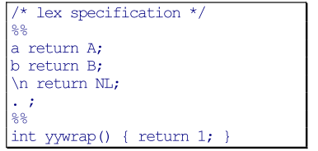
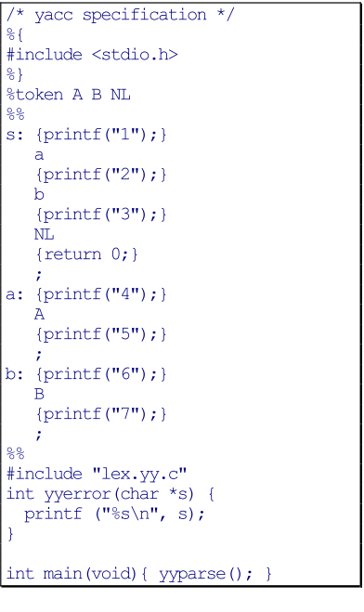
Actions between Rule Elements
input: ab
output: 1452673
input: aa
output: 14526 syntax error
input: ba
output: 14 syntax error

Slide 33
References
• http://memphis.compilertools.net/interpreter.html
• http://www.opengroup.org/onlinepubs/007908799/xcu/yacc.html
• http://dinosaur.compilertools.net/yacc/index.html

